Slide 1


BasicCommandsof
MySQL
Fundamentals and Background
Notes:
There are basic commands in SQL that you should know. The basic commands to create a database and a table. A database is a group of tables. Tables hold data .

Slide 2
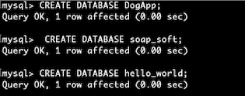
Commands for a Database
To create a database the syntax is:
create database <database name>;
For example:
Notes:
To create a database the syntax is: create database <database name>;

Slide 3
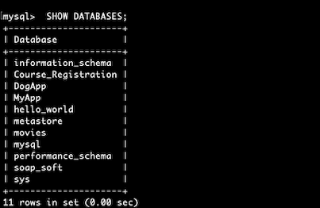
Commands for a Database (count.)
To show what databases are in the system the syntax is:
show databases;
For example:
Notes:
To show what databases are in the system the syntax is: show databases;

Slide 4

Commands for a Database (count.)
To select a database to work with the syntax is:
select database ();
For example
Notes:
To select a database to work with the syntax is: select database ();

Slide 5

Commands for a Database (count.)
To use the selected database and create a table for it the syntax is:
use <database name>;
For example:
Notes:
To use the selected database and create a table for it the syntax is: use <database name>;

Slide 6
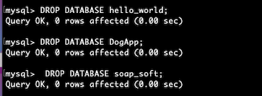
Commands for a Database (count.)
To drop a database the syntax is:
drop database <database name>;
For example:
Notes:
To drop a database the syntax is: drop database <database name>;

Slide 7
Commands for a Table
To create a table for a database the syntax is:
create table <table name>;
For example:
Notes:
To create a table for a database the syntax is: create table <table name>;

Slide 8

Commands for a Table (count.)
To show tables in the database the system the syntax is:
show tables;
For example:
Notes:
To show tables in the database the system the syntax is: show tables;

Slide 9
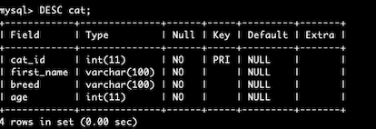
Commands for a Table (count.)
To show characterizes of a table you created the syntax is:
describe <table name>;
For example:
Notes:
To show characterizes of a table you created the syntax is: describe <table name>;

Slide 10

Commands for a Table (count.)
To drop a table in a database the syntax is:
drop table <table name>;
For example:
Notes:
To drop a table in a database the syntax is: drop table <table name>;

Slide 11
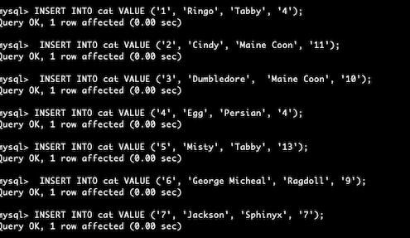
Commands for a Table (count.)
You insert data in the table by using the syntax:
insert into <tablename> value (<data information>);
For example:
Notes:
You insert data in the table by using the syntax: insert into <tablename> value (<data information>);

Slide 12
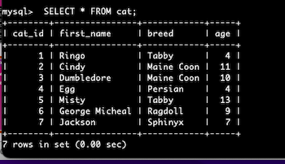
Commands for a Table (count.)
To show information from table you created you use the syntax:
select * from <tablename>;
For example:
Notes:
To show information from table you created you use the syntax: select * from <tablename>;

